Slide 1
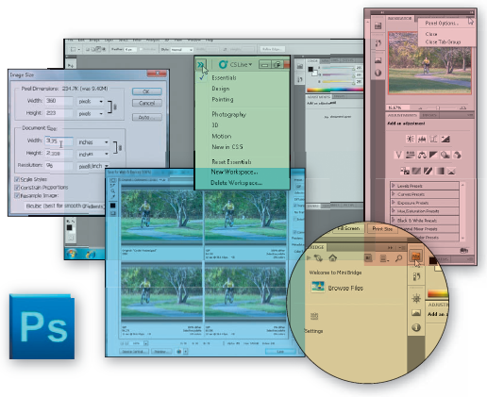
University of Basrah - College of Computer Science and Information Technology
Computer Applications (COMP 105)
1st Year
Dr. Mustafa Moosa Qasim
(mustafa_mq87@yahoo.com)
Mr. Sarmad Asaad Saleem
(sarmad.saleem@uobasrah.edu.iq)

Slide 2
Objectives
Start Photoshop and customize the Photoshop workspace
Open a photo
Identify parts of the Photoshop workspace
Explain file types
Save a photo for both print and the Web
View a photo using the Zoom Tool, Navigator panel, Hand Tool, and screen modes
Display rulers

Slide 3
Objectives
Crop a photo using the Rule of Thirds overlay
Create a blended border by stroking a selection
Open a recent file
Resize a photo
Print a photo
View files in Mini Bridge
Access Photoshop Help
Close a file
Quit Photoshop

Slide 4
TERMS TO KNOW!!!! YOU WILL SEE THESE ON A TEST!!
What is Photoshop CS5?
Photoshop CS5 is a popular image editing software program produced by Adobe System Incorporated.
Image Editing software refers to computer programs that all you to create and modify digital images.
Digital Images are pictures in electronic form.
One type of digital image is a photograph or photo, a picture taken with a camera and stored as a digital file.

Slide 5
TERMS TO KNOW!!!! YOU WILL SEE THESE ON A TEST!!
Digital images are used in graphic applications such as advertising, print publishing, and the Web.
Photoshop can be used for basic adjustments such as rotating, cropping, or resizing.
Rack Card is a popular form of advertising, typically measuring 4x9 inches and printed in color on both sides.

Slide 6
Project – Rock Card Graphic

Slide 7
General Project Guidelines
Find an appropriate image or photo
Determine how to edit the photo to highlight the theme
Identify finishing touches that will further enhance the photo
Prepare for publication

Slide 8
Starting Photoshop
Click the Start button on the Windows 7 taskbar to display the Start menu
Type Photoshop CS5 as the search text in the ‘Search programs and files’ text box, and watch the search results appear on the Start menu
Click Adobe Photoshop CS5 in the search results on the Start menu to start Photoshop
After a few moments, when the Photoshop window is displayed, if the window is not maximized, click the Maximize button next to the Close button on the title bar to maximize the window

Slide 9
Starting Photoshop You will see this on a test to label the parts of the Photoshop Workspace.

Slide 10
TERMS TO KNOW!!!! YOU WILL SEE THESE ON A TEST!!
Photoshop does not open a blank or default photo automatically.
Photoshop does open the Application Bar, a menu bar, and the options bar appear across the top of the screen with a gray work area below the options bar.
The Tool panel is displayed on the left and other panels are displayed on the right.
The gray work area and panels are referred to as the workspace.

Slide 11
Selecting the Essentials Workspace
Click the ‘Show more workspaces and options’ button on the Application bar to display the names of saved workspaces
If necessary, click Essentials to select the default workspace panels
Click the ‘Show more workspaces and options’ button again to display the list
Click Reset Essentials to restore the workspace to its default settings and reposition any panels that may have been moved

Slide 12
Selecting the Essentials Workspace

Slide 13
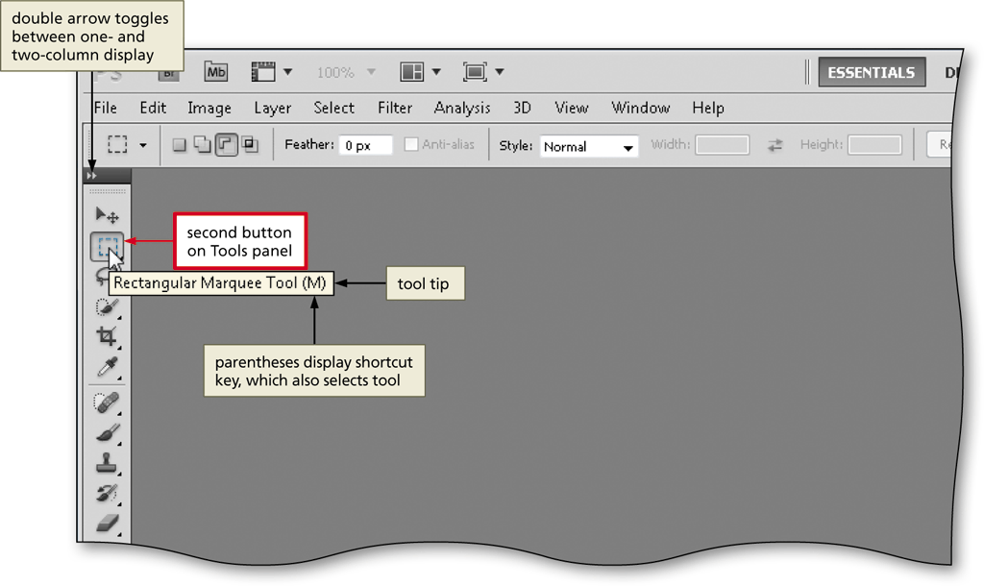
Resetting the Tools Panel
If necessary, click the second button from the top on the Tools panel to select it
If the tools in the Tools panel appear in two columns, click the double arrow at the top of the Tools panel

Slide 14
Resetting the Options Bar
Right-click the Rectangular Marquee Tool icon on the options bar to display its context menu
Click Reset All Tools to display a confirmation dialog box
Click the OK button to restore the tools to their default settings

Slide 15
Resetting the Options Bar

Slide 16
TERMS TO KNOW!!!! YOU WILL SEE THESE ON A TEST!!
The options bar is context sensitive which means it changes as you select different tools.
A context menu appears when you right-click some objects in the Photoshop workspace. The menu displays commands representing the active tool, selection, or panel.

Slide 17
Opening a Photo
Click File on the menu bar to display the File menu
Click Open on the File menu to display the Open dialog box
Click the Look in box arrow to display a list of available storage locations, and then select the desired storage location
Navigate to the location of the photo you wish to open, and then click the file to select it
Click the Open button to open the selected file and display the open photo in the Photoshop workspace

Slide 18
Opening a Photo

Slide 19
The Application Bar – You will need to know this so you can label it on a test.

Slide 20
The Menu Bar and the Options Bar

Slide 21
TERMS TO KNOW!!!! YOU WILL SEE THESE ON A TEST!!
The menu bar is a tool bar that displays the Photoshop menu names.
Each menu contains a list of commands you can use to perform tasks such as opening, saving, printing, and editing photos.
To display a menu, such as the View menu, click the View menu name on the menu bar. If you point to a command on a menu that has an arrow on its right edge, a submenu, displays another list of commands.

Slide 22
The Tools Panel – get familiar with the tool bar, we will use it to edit all images.

Slide 23
TERMS TO KNOW!!!! YOU WILL SEE THESE ON A TEST!!
The tools panel is on the left hand side of the workspace.
The tools panel is a group of tools, or buttons, organized into a tool-bar. Each tool on the tools panel displays a tool icon.
When you point to an icon on the tools panel, you see a tool tip..A tool tip tells you the name of the tool. If there is an arrow on the tool icon, there are additions tools associated with the button.

Slide 24
The Document Window is the light gray area within the workspace that displays the active file or image.
Photoshop displays a title bar, or document window tab, at the top of the document window that shows the name of the file, the magnification, the color mode, and a Close button.

Slide 25
TERMS TO KNOW!!!! YOU WILL SEE THESE ON A TEST!!
Display Area is the portion of the document window that displays the photo or image.
Scroll Bars appear on the right and bottom of the document window. When the photo is bigger than the document window, the scroll bars become active and display scroll arrows and scroll boxes to move the image up, down, right, or left.

Slide 26
A Panel is a collection of graphically displayed choices and commands, such as those involving colors, brushes, actions, or layers.
A panel group displays several panels horizontally. A panel group is displayed on the right side of the workspace.

Slide 27
TERMS TO KNOW!!!! YOU WILL SEE THESE ON A TEST!!
A file type refers to the internal characteristics of digital files.
2 file types we will use the most are:
PSD- Photoshop Document…PSD format is the default file format in Photoshop and the only format that supports all Photoshop features.
JPEG – Joint Photographic Experts Group… JPEG files are used to display photos on web pages and digital cameras produce JPEG images.

Slide 28
Saving a Photo in the PSD Format
Click File on the menu bar to display the File menu
Click Save As to display the Save As dialog box
Type the desired file name in the File name text box
Navigate to the desired save location
Click the Format button to display the list of available file formats
Click Photoshop (*.PSD, *.PDD) to select it
Click the Save button to save the document

Slide 29
Saving a Photo in the PSD Format

Slide 30
Saving Files
If you are not finished with as assignment, you must save it as a .PSD File in order to be able to complete the assignment at the next class.
I you are finished with an assignment, and are ready to submit for grading, you will save it as a .JPEG file. When you save as a .JPEG file, it merges all layers together and you can not go back and edit it. You will have to start over again.

Slide 31
Zoom Tool allows you to focus on certain areas of a photo that you want to edit.
Click the Zoom Tool button on the Tools panel to select the Zoom tool
Move the mouse pointer into the document window to display the magnifying glass mouse pointer
Click the location of the photo on which you wish to zoom in until the photo is zoomed to the desired level

Slide 32
Using the Zoom Tool

Slide 33
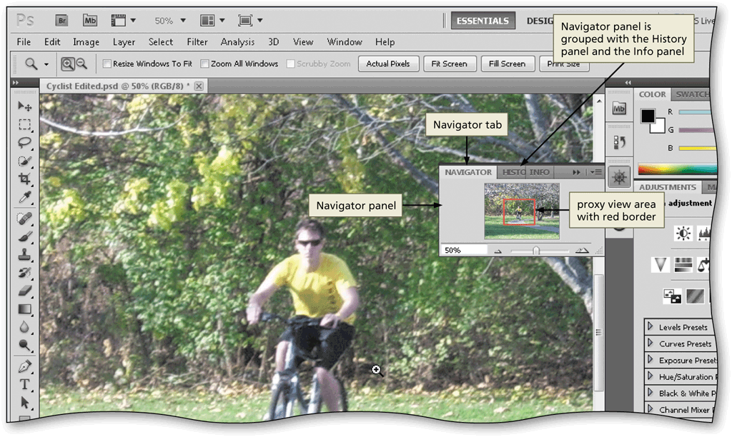
Opening the Navigator Panel
Click Window on the menu bar to display the Window menu
Click Navigator on the Window menu to open the Navigator panel

Slide 34
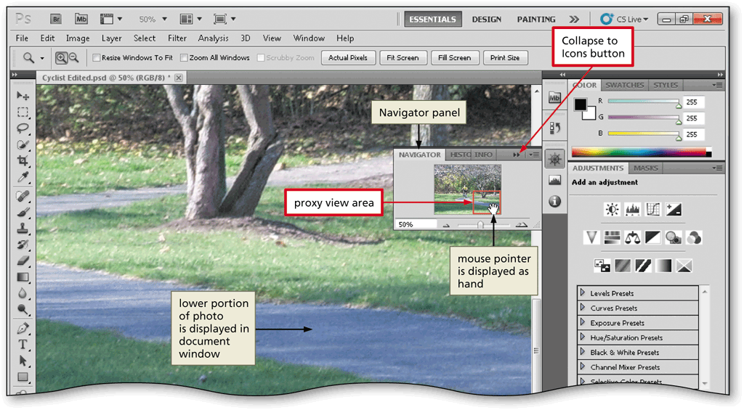
Navigator Panel is another way to zoom in and move around your photo.
Drag the proxy view area on the Navigator Panel to display the desired portion of the photo

Slide 35
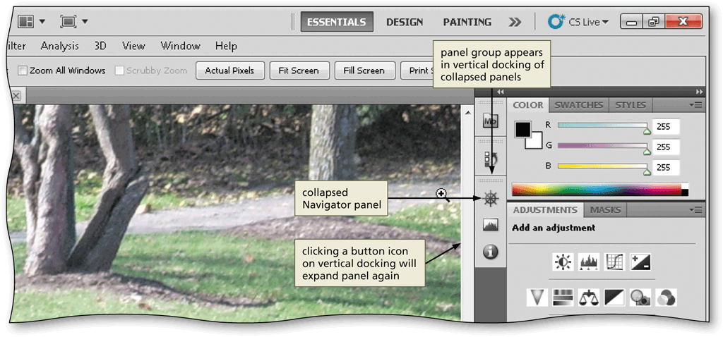
Collapsing the Navigator Panel
Click the Collapse to Icons button on the Navigator panel title bar to collapse the Navigator panel

Slide 36
Hand Tool is another way to move around a photo if it is to big for the document window.
Click the Hand Tool button on the Tools panel to select the Hand Tool
Drag in the document window to display the center portion of the photo

Slide 37
Using the Hand Tool

Slide 38
Changing the Magnification
Double-click the magnification box on the status bar to select the current magnification
Type the desired magnification and then press the ENTER key to change the magnification

Slide 39
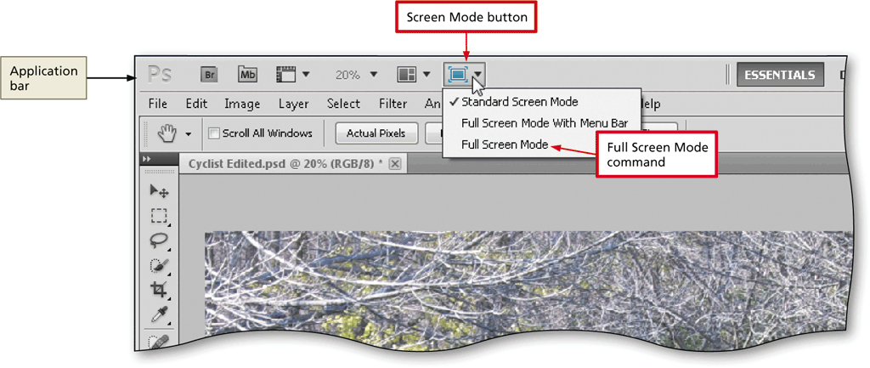
Changing the Screen Mode
On the Application bar, click the Screen Mode button to display its menu
Click Full Screen Mode to display the Message dialog box
Click the Full Screen button to view the document in full screen mode
Press the F key to exit full screen mode

Slide 40
Screen Modes
Standard Screen Mode displays the Application bar, menu bar, options bar, document window, scroll bars, and visible panels.
Full Screen Mode displays only the image and rulers, if they are visible on a black background.
Full Screen Mode with Menu enlarges the document window to fill the workspace and combines the Application bar and menu bar with no status bar or scroll.

Slide 41
Displaying Rulers
On the Application bar, click the View Extras button to display its menu
Click Show Rulers to display the rulers in the document window

Slide 42
Displaying Rulers

Slide 43
Editing the Photo
Transformations
Enhancements and Layering
Color
Correction
File Type
Resolution

Slide 44
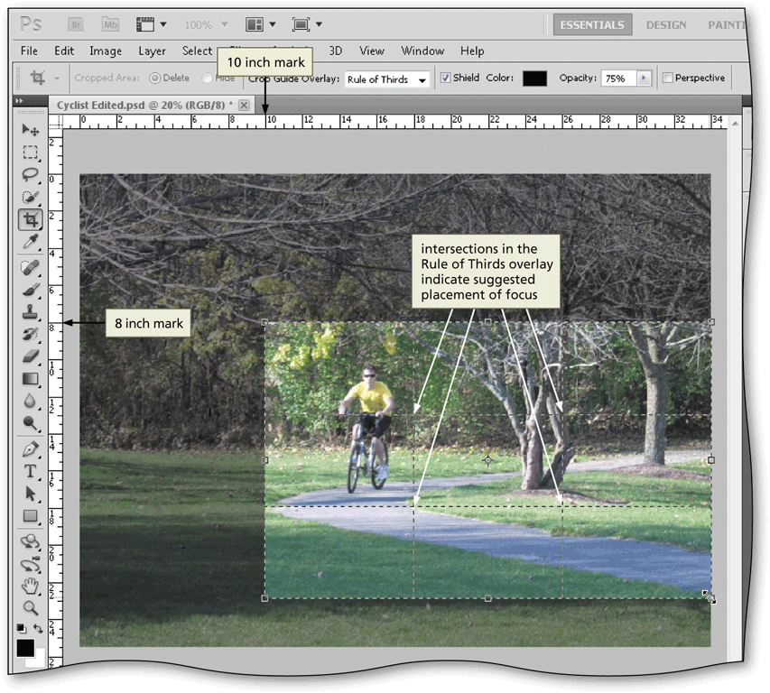
Cropping a Photo to cut away part of the image that you do not need.
Click the Crop Tool button on the Tools panel to select the Crop Tool
Drag a rectangle around the area of the photo to retain
Rule of Thirds means to imagine that the photo is divided into thirds placing the focus on the most important part of the photo.

Slide 45
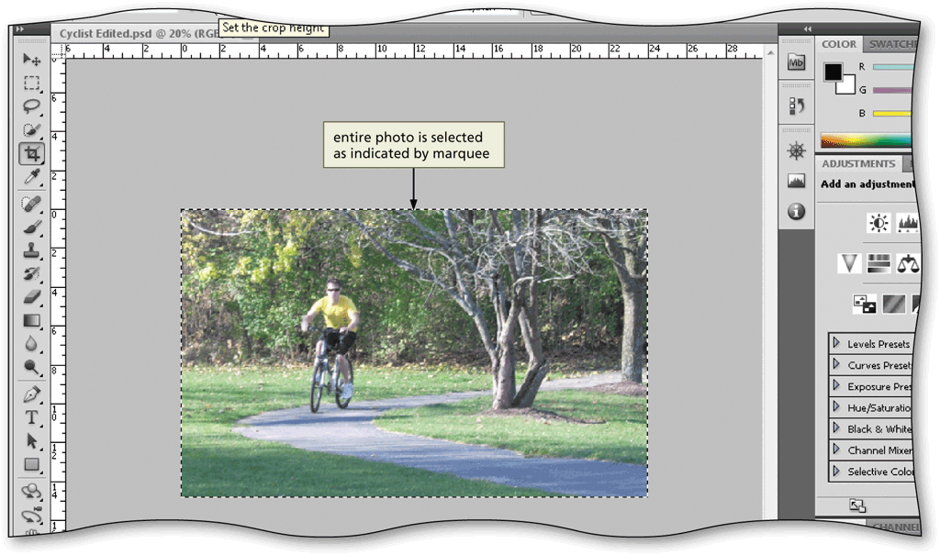
Creating a Selection
On the menu bar, click Select to display the Select menu
On the Select menu, click All to display the selection marquee around all of the photo
A marquee is a flashing or pulsating border around an image, it is also referred to as marching ants.

Slide 46
Stroking a Selection
With the photograph selected, click Edit on the menu bar to display the Edit menu
Click Stroke to display the Stroke dialog box
Type the desired width in the Width box
Click the desired stroke location
Click the OK button to apply the stroke

Slide 47
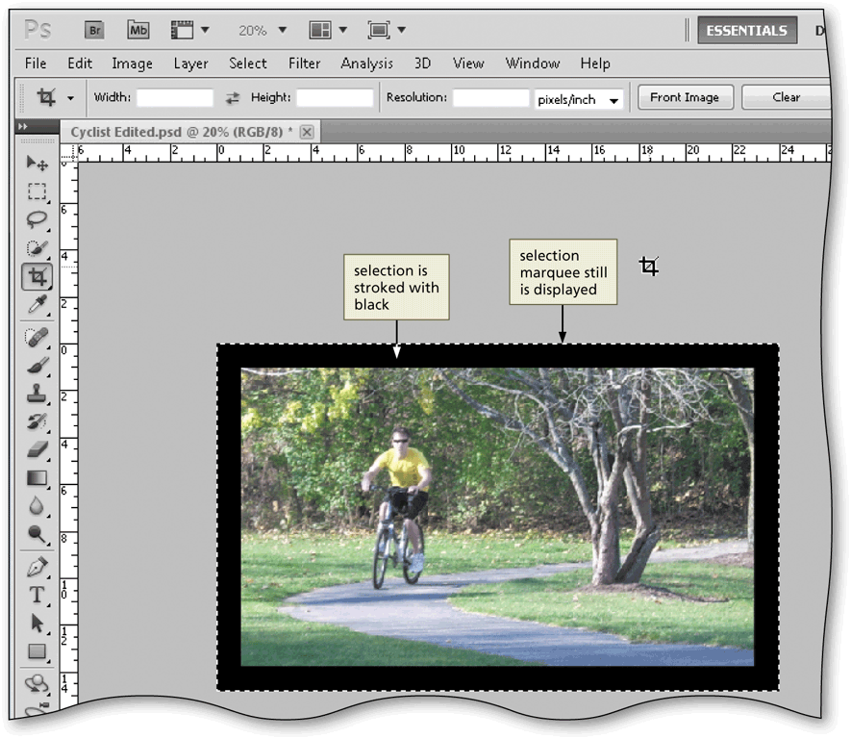
Stroke is a colored outline around a photo.

Slide 48
Modifying a Selection
On the menu bar, click Select, and then point to Modify to display the Modify submenu
Click Border on the Modify submenu to display the Border Selection dialog box
Type the desired width in the Width box to create a border on each side of the photo
Click the OK button in the Border Selection dialog box to define the selection

Slide 49
Modifying a Selection

Slide 50
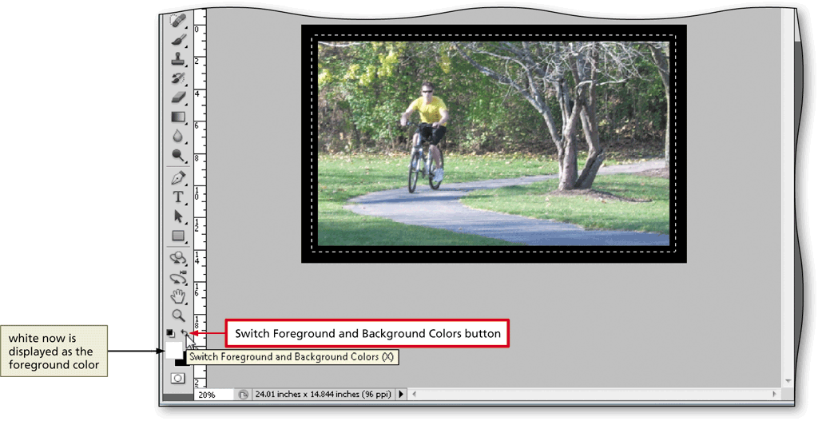
Switching Foreground and Background Colors
Click the Switch Foreground and Background Colors button to reverse the colors

Slide 51
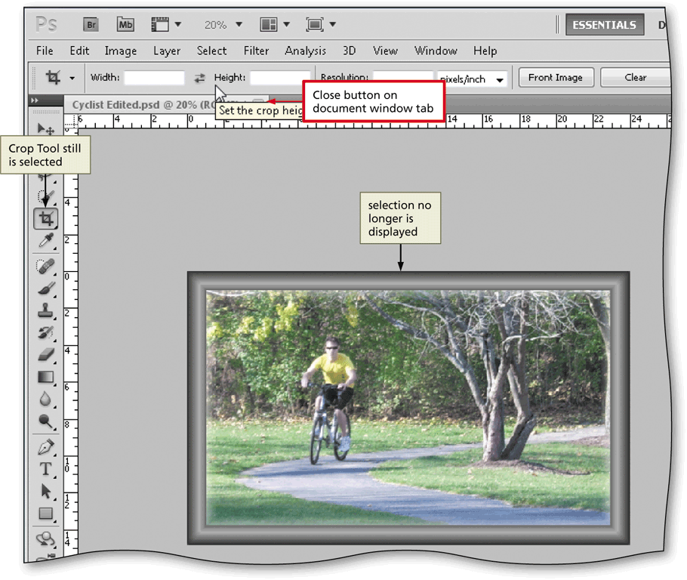
Deselecting
Click Select on the menu bar and then click Deselect to remove the selection

Slide 52
Saving a Photo with the Same File Name
Click File on the menu bar and then click Save to save the photo with the same file name

Slide 53
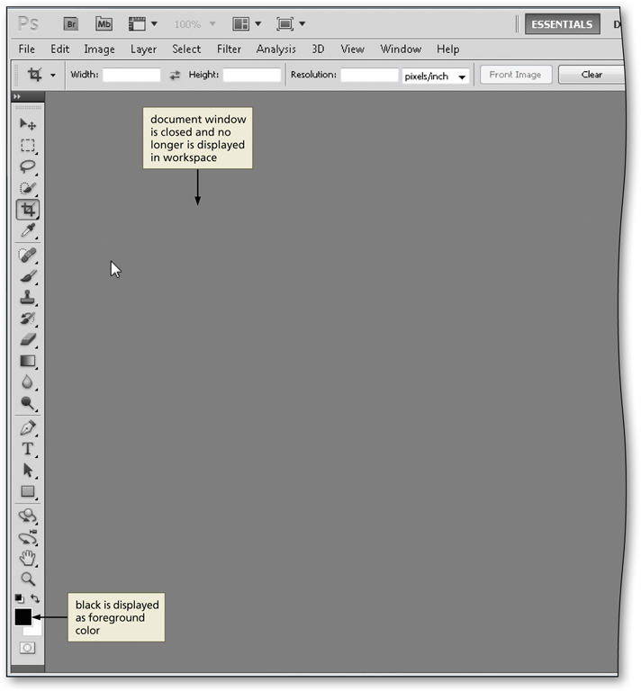
Closing a Photo
Click the Close button on the Document window tab to close the document window and the image file

Slide 54
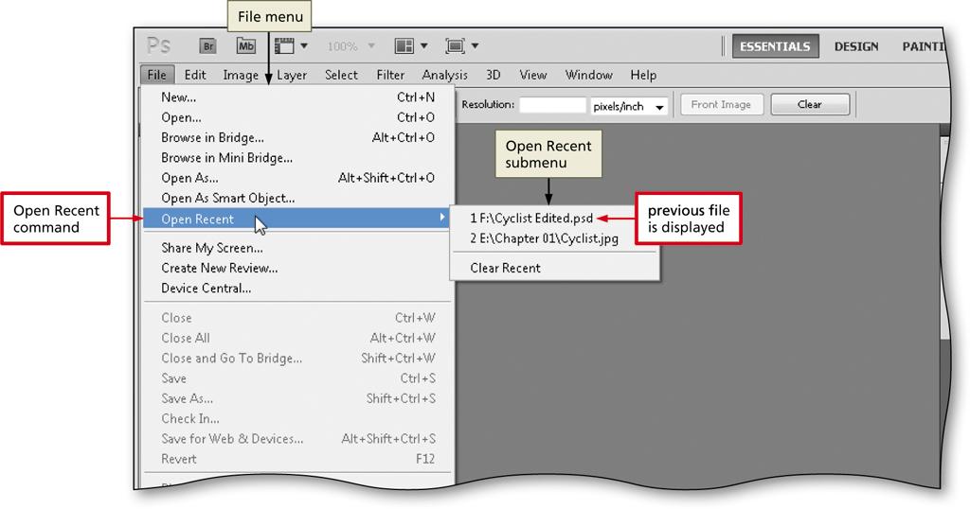
Opening a Recent File
Click File on the menu bar and then point to Open Recent to display the Open Recent submenu
Click the desired file on the Open Recent submenu to open the file

Slide 55
Resizing the Image
Click Image on the menu bar to display the Image menu
Click Image Size to display the Image Size dialog box
In the Document Size area, set the desired width and height
Click the OK button to finish resizing the image

Slide 56
Resizing the Image…Resize means to scale or change the dimensions of the photo.
Photoshop uses a mathematical process called interpolations or resampling, when is changes the number of pixels.
Resolution refers to the number of pixels per inch, printed on a page or displayed on a monitor.

Slide 57
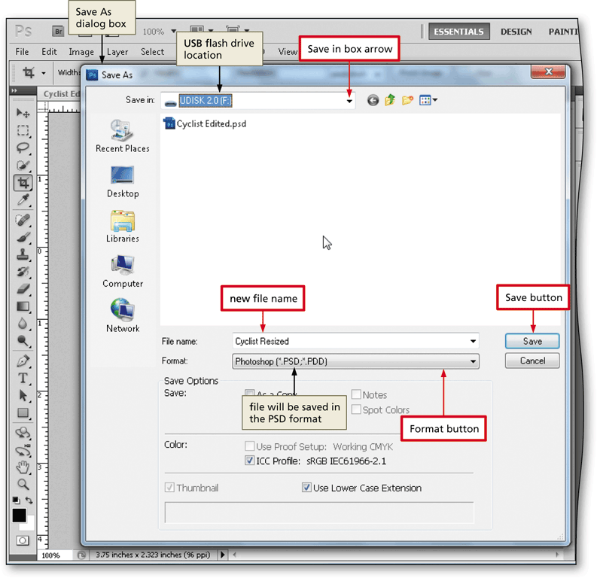
Saving a Photo with a Different Name
Click File on the menu bar and then click Save As to display the Save As dialog box

Slide 58
Printing a Photo
Ready the printer according to the printer instructions
Click File on the menu bar and then click Print to display the Print dialog box
If necessary, click the Printer box arrow and then select your printer from the list. Do not change any other settings
In the Print dialog box, click the Print button to start the printing process. If your system displays a second Print dialog box or a Print Settings dialog box, unique to your printer, click its Print button
When the printer stops, retrieve the hard copy of the photo
A printed version of a photo is called a hardcopy or printout.

Slide 59
Printing a Photo

Slide 60
Previewing Using the Save for Web & Devices Dialog Box
Click File on the menu bar to display the File menu and then click Save for Web & Devices to display the Save for Web & Devices dialog box
Click the 4-Up tab to display four versions of the photo
Click the upper-right preview, if necessary, to choose a high-quality version of the photo

Slide 61
Previewing Using the Save for Web & Devices Dialog Box

Slide 62
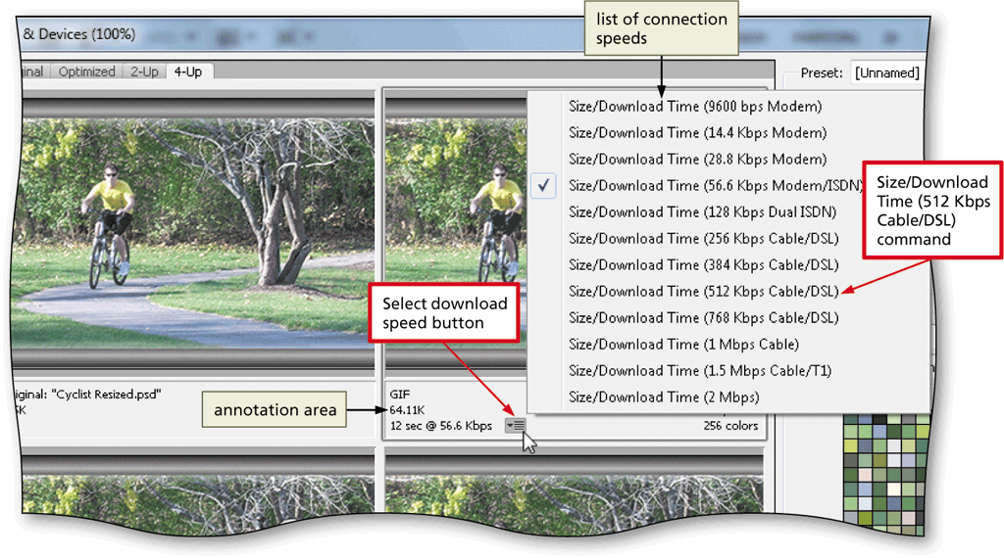
Choosing a Download Speed
In the annotation area below the upper-right preview, click the ‘Select download speed’ button to display the list of connection speeds
In the list, click the desired download speed

Slide 63
Previewing a Photo on the Web
Click the Preview button to display the photo in a Web browser
If necessary, double-click the browser’s title bar to maximize the browser window
Click the Close button on the browser’s title bar to close the browser window

Slide 64
Previewing a Photo on the Web

Slide 65
Saving a Photo as a Web Page
In the Save for Web & Devices dialog box, click the Save button to display the Save Optimized As dialog box
Type the desired file name in the File name text box
Navigate to the desired save location
Click the Format button to display the saving options
Click HTML and Images in the list to direct Photoshop to save the HTML code and the Web version of the photo
Click the Save button to save the HTML and Image files

Slide 66
Saving a Photo as a Web Page

Slide 67
Using Mini Bridge to View Files
Click the Mini Bridge button in the vertical docking to open the Mini Bridge panel
Click the Panel View button to display the panel settings
Click Navigation Pod to display common and recent locations, as well as the Content area
If Photoshop displays a dialog box asking if you want to start Bridge each time you log in, click the No button
Navigate to the location containing the files to view

Slide 68
Using Mini Bridge to View Files
In the lower-right corner of the Mini Bridge panel, click the View button to display a menu of other ways to view photos in Mini Bridge
Click As Details to show more information about each photo
If necessary, drag the slider to see more of the details
Click the Collapse to Icons button on the Mini Bridge panel title bar to collapse the panel

Slide 69
Using Mini Bridge to View Files

Slide 70
Accessing Photoshop Help
With Photoshop open on your system, press the F1 key to access Photoshop Help online
If necessary, double-click the title bar to maximize the window

Slide 71
Accessing Photoshop Help

Slide 72
Using the Help Search Box
Click to display a check mark in the ‘Search current site only’ or ‘Adobe reference only’ check box
Click the Search box and then type the desired search topic
Press the ENTER key to display the relevant links
Click the desired link to display the contents
Scroll as necessary to read the information

Slide 73
Using the Help Search Box

Slide 74
Course Summary
Start Photoshop and customize the Photoshop workspace
Open a photo
Identify parts of the Photoshop workspace
Explain file types
Save a photo for both print and the Web
View a photo using the Zoom Tool, Navigator panel, Hand Tool, and screen modes
Display rulers

Slide 75
Course Summary
Crop a photo using the Rule of Thirds overlay
Create a blended border by stroking a selection
Open a recent file
Resize a photo
Print a photo
View files in Mini Bridge
Access Photoshop Help
Close a file
Quit Photoshop

